Slide 1
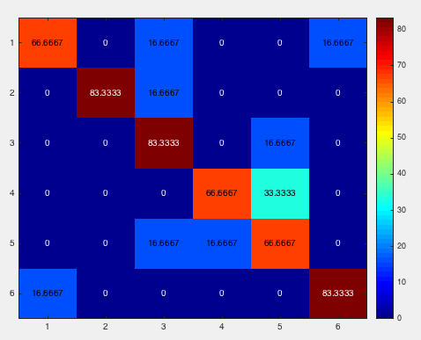
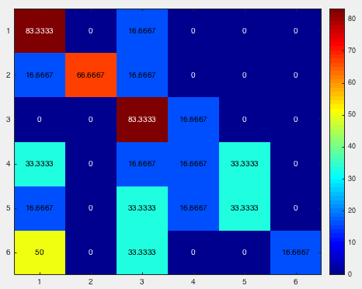
Irene1_18motionparameter_byrun_4masks
mask1
mask2

Slide 2
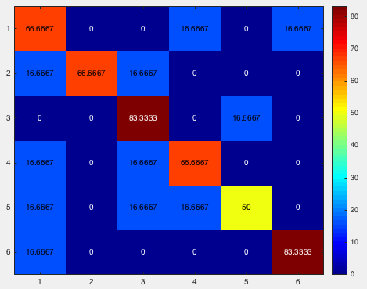
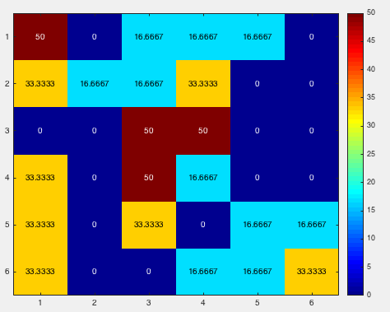
Irene1_18motionparameter_byrun_4masks
mask3
mask4

Slide 3
Irene1_18motionparameter_byrun_4masks
mask5

Slide 4
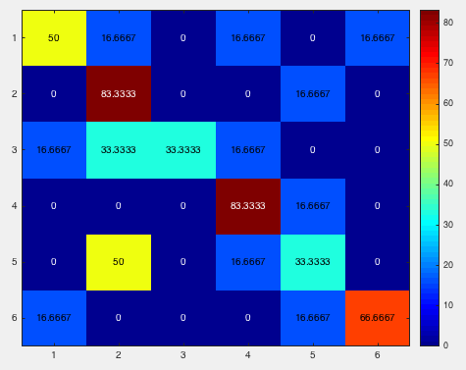
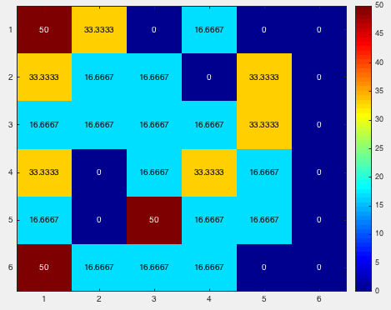
luo_18motionparameter_byrun_4masks
mask1
mask2

Slide 5
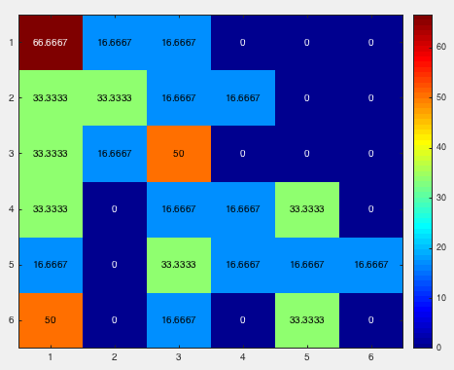
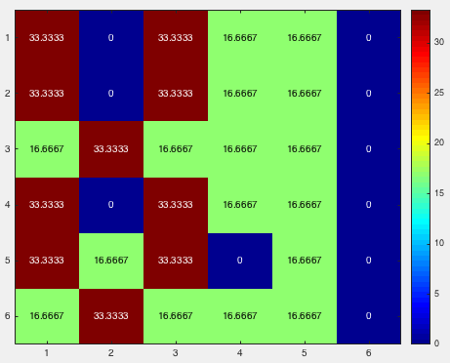
luo_18motionparameter_byrun_4masks
mask3
mask4

Slide 6
luo_18motionparameter_byrun_4masks
mask5

Slide 7
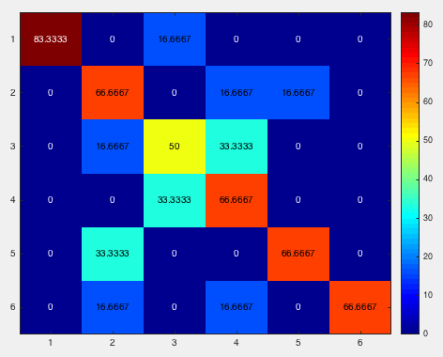
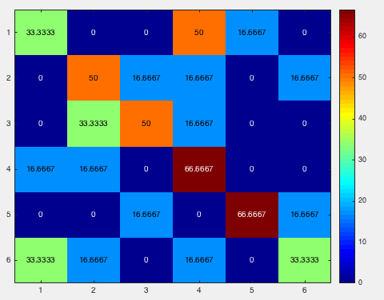
Irene2_18motionparameter_byrun_4masks
mask1
mask2

Slide 8
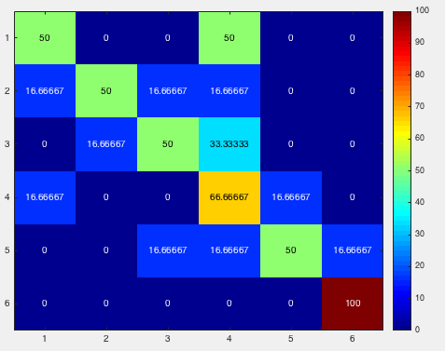
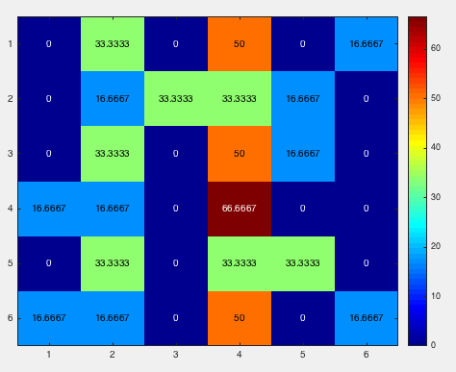
Irene2_18motionparameter_byrun_4masks
mask3
mask4

Slide 9
Irene2_18motionparameter_byrun_4masks
mask5

Slide 10
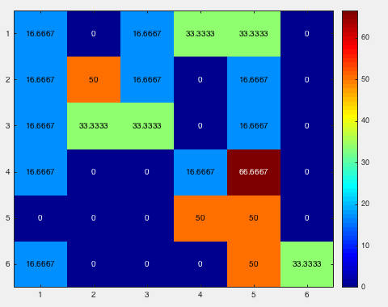
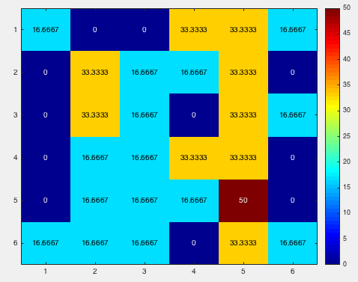
angela_18motionparameter_byrun_4masks
mask1
mask2

Slide 11
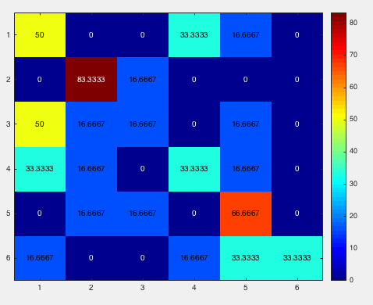
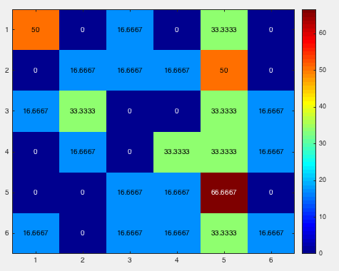
angela_18motionparameter_byrun_4masks
mask3
mask4

Slide 12
angela_18motionparameter_byrun_4masks
mask5

